Slide 1

QORVO_RADIO2
10/17/2025 Meeting

Slide 2
KiCad Development
Symbols completed
Started footprint development
Footprints completed
Battery Housing
Buck Converter
QPG6200L
Crystal Oscillator
ADC
Audio Amplifier
Footprints NOT completed
Microphone
Through holes for external devices (Speaker, Doorbell, Lighting, ultrasonic sensor)
J-Link header
Inductors & Diodes

Slide 3
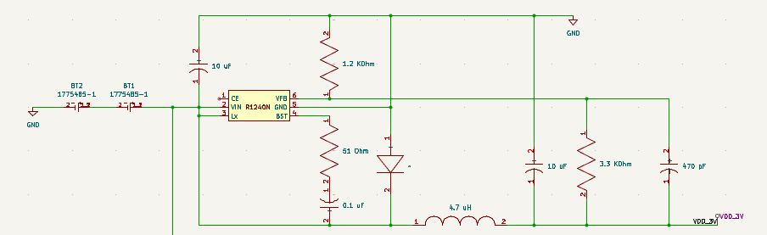
Power Supply Circuit

Slide 4
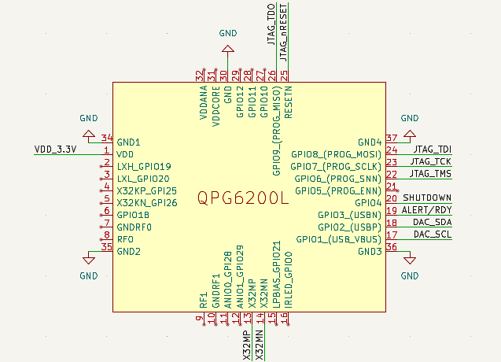
QPG6200L Symbol

Slide 5
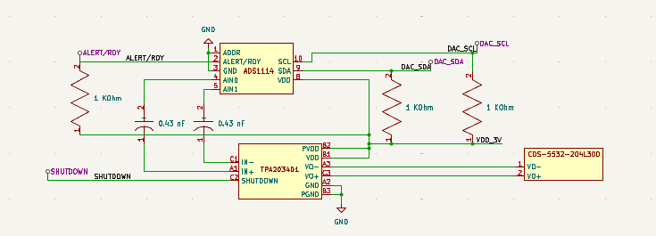
Audio Speaker Circuit

Slide 6
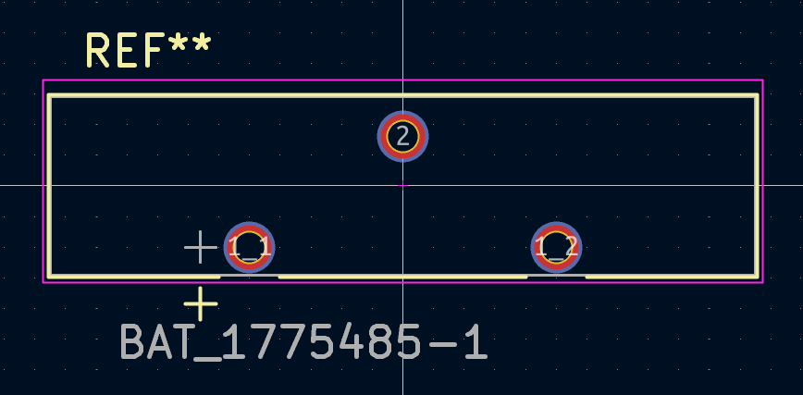
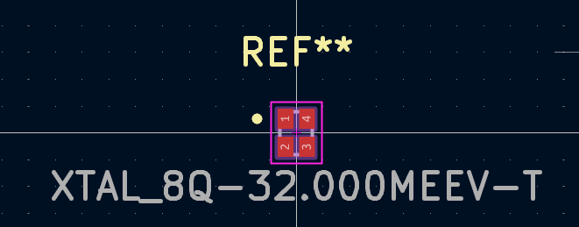
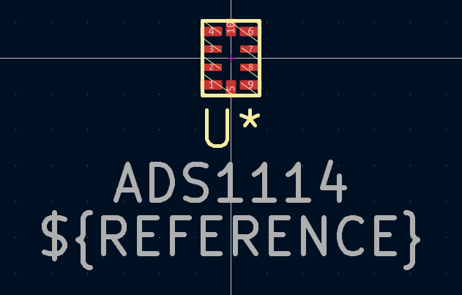
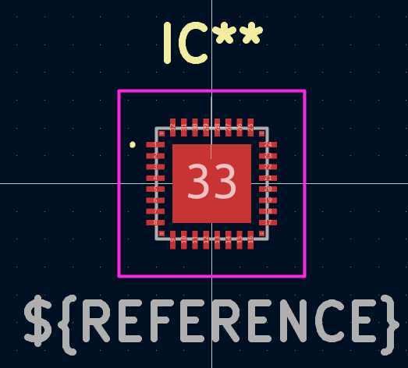
Footprints

Slide 7
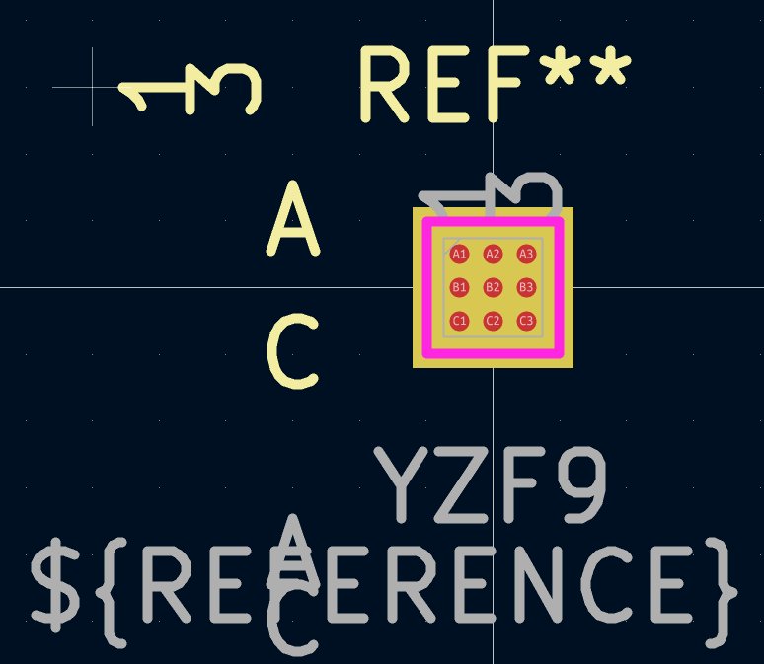
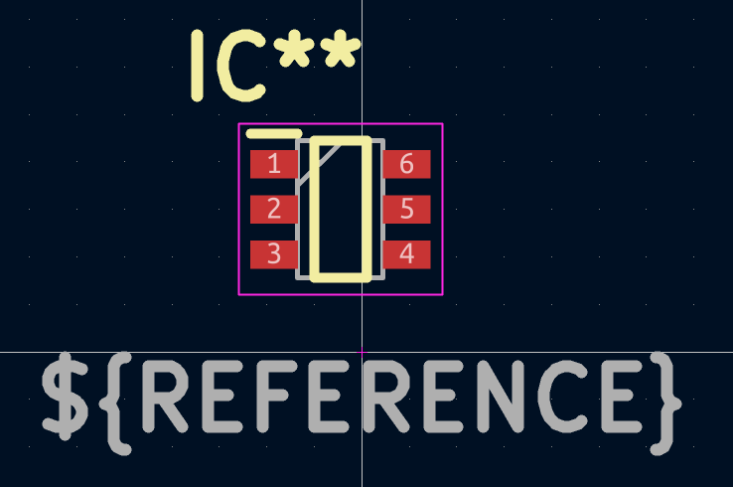
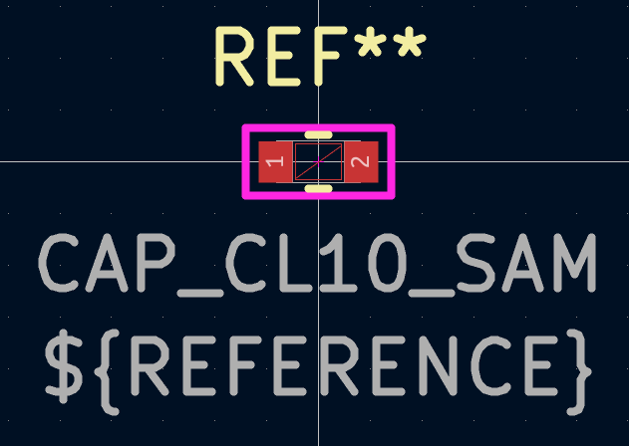
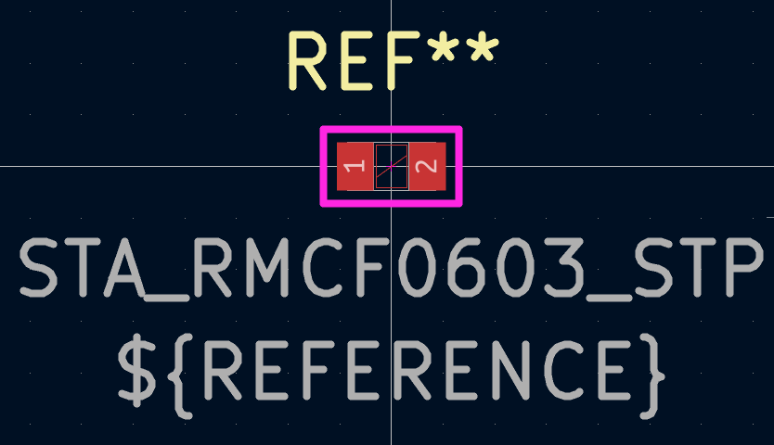
Footprints continued

Slide 8
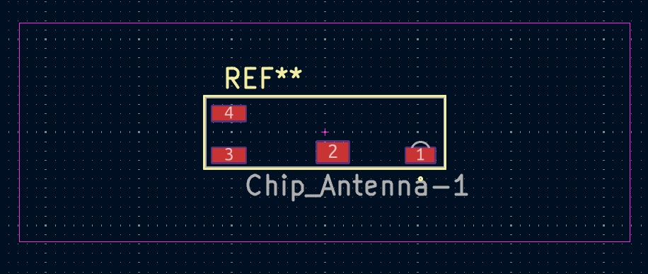
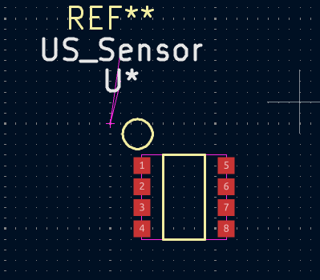
Footprints

Slide 9
Recent Progress
Downloaded UI (ThingsBoard) to Provided Linux Laptop
Initial Setup completed
Learning to Activate/Configure different Peripherals using the provided devkit
Downloaded SDK and accessed the development container through VS Code
Exploring Bluetooth, Zigbee/Thread, and Matter protocols for device communication

Slide 10
Upcoming Goals
Learn to use and setup Gateway
Set up initial RF Communication Test
Integrate peripherals with ThingsBoard UI for real-time monitoring
Investigating Zigbee Light Link (ZLL) and BLE services and characteristics for device control and communication
Investigate more on IEEE 802.11 (WiFi) for gateway communication with tablet
Run some example applications in the SDK on the QPG6200L DevKit

Slide 11
Questions
User Interface Hosting:
Is local hosting of the UI acceptable or should it be cloud based for multi-device access?
Gateway:
Any guidance on integrating Wi-Fi (IEEE 802.11) for gateway communication with ThingsBoard or a tablet?
SDK:
Are there recommended resources or documentation for using the Qorvo SDK more effectively?

Slide 12
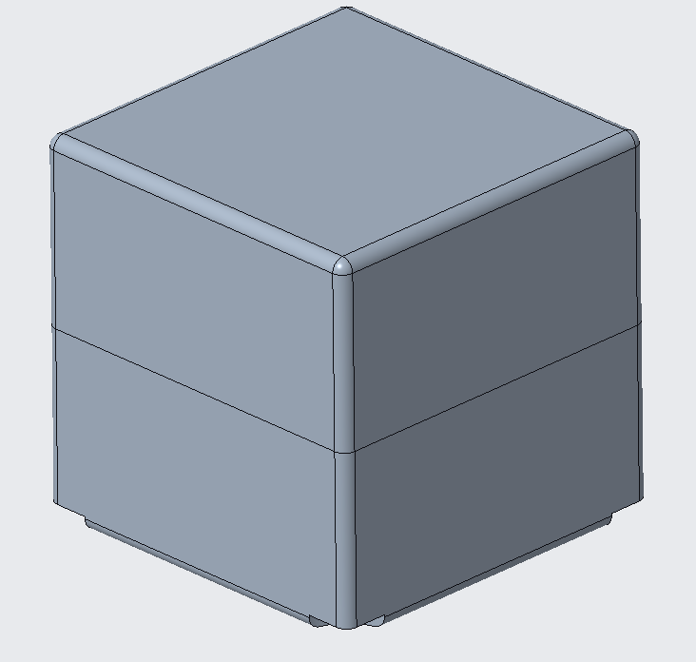
Enclosure Template
Template
Antenna cutout?

Slide 13
PDR Presentation
November 7, 2025
9am
Room TBD

Slide 14
Next Week’s Meeting
10/24/2025
ISL Safety Lecture

